Slide 1
FraudDroid: Automated Ad Fraud Detection for Android Apps
Feng Dong, Haoyu Wang, Li Li, Yao Guo,
Tegawende F. Bissyande, Tianming Liu, Guoai Xu, Jacques Klein

Slide 2
Background
Developers get compensated by leveraging in-app ads
Frauds in mobile ads
Current work: mainly focused on “static placement fraud”

Slide 3
Contributions
A taxonomy of existing mobile ad frauds
FraudDroid: a new approach to detect mobile ad frauds based on UI transition graph and network traffic analysis
Demonstrate FraudDroid can scale to markets

Slide 4
A taxonomy of mobile ad frauds
Static Placement Fraud
Ad Hidden fraud
Ad Size fraud
Ad Number fraud
Ad Overlap fraud

Slide 5
A taxonomy of mobile ad frauds
Dynamic Interaction Fraud
Interaction Ad fraud
Driven-by download Ad fraud
Outside Ad fraud
Frequent Ad fraud
Non-content Ad fraud

Slide 6
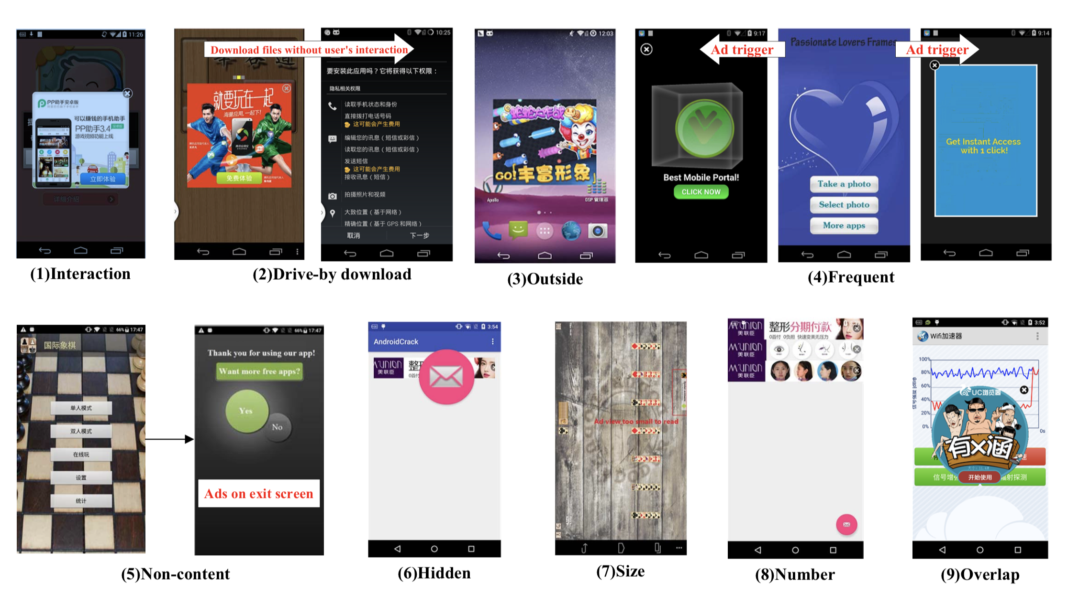
Case Study

Slide 7
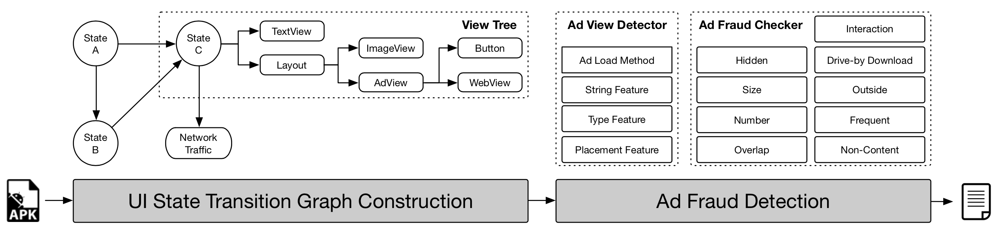
FRAUDDROID
Analysis and Modelling of UI states
Heuristics-base detection of ad frauds

Slide 8
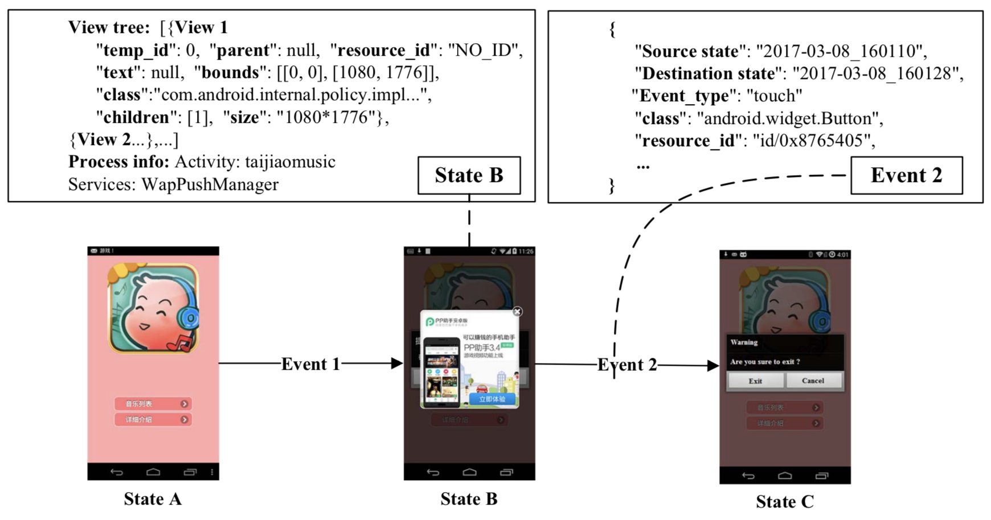
FRAUDDROID
Analysis and modelling of UI states
Ad-First Exploration Strategy

Slide 9
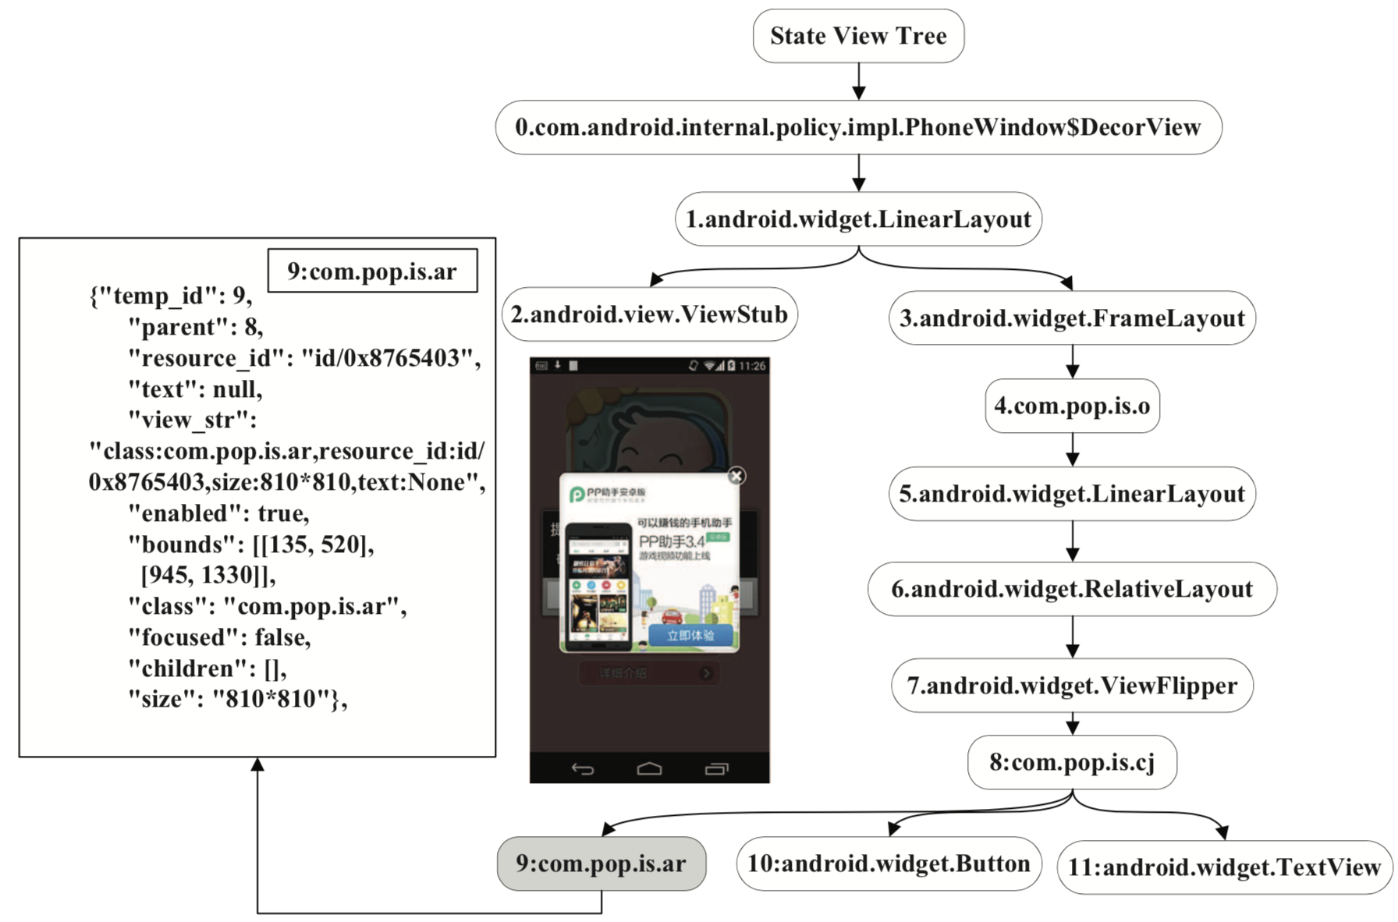
FRAUDDROID
Analysis and modelling of UI states
View Tree Construction

Slide 10
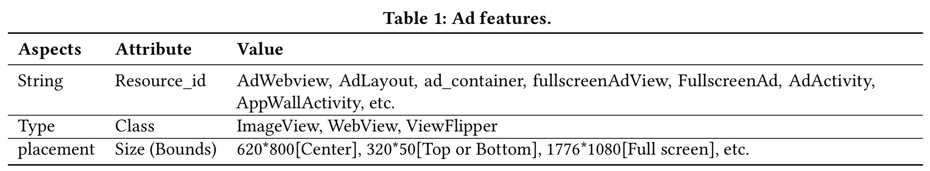
FRAUDDROID
Heuristics-based Detection of Ad Fruads
AdViewDetector: Detection of Ad Views
String
Type
Placement

Slide 11
FRAUDDROID
Heuristics-based Detection of Ad Fruads
FraudChecker: Identification of Fraudulent Behavior
Ad Hidden fraud
Feature: z-index …
Ad Size fraud
Predefined ratio: banner ads[0.004, 0.005], interstitial ads[0.2, 0.8] …
Ad Number fraud
Combined space occupied by all ads in a UI state
Ad Overlap fraud
Similar to hidden fraud

Slide 12
FRAUDDROID
Heuristics-based Detection of Ad Fruads
FraudChecker: Identification of Fraudulent Behavior
Interaction Ad fraud
Driven-by download Ad fraud
Outside Ad fraud

Slide 13
FRAUDDROID
Heuristics-based Detection of Ad Fruads
FraudChecker: Identification of Fraudulent Behavior
Frequent Ad fraud
Non-content Ad fraud

Slide 14
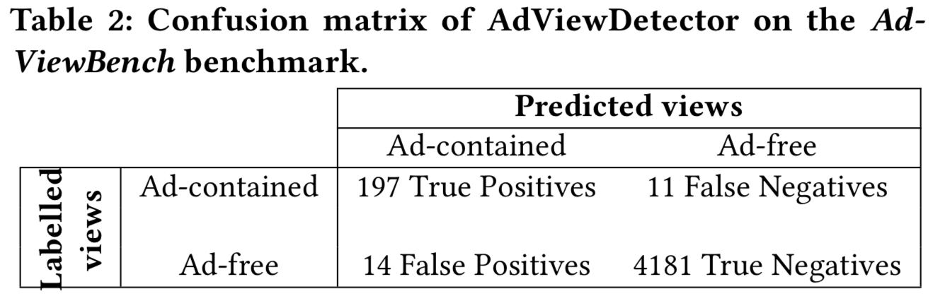
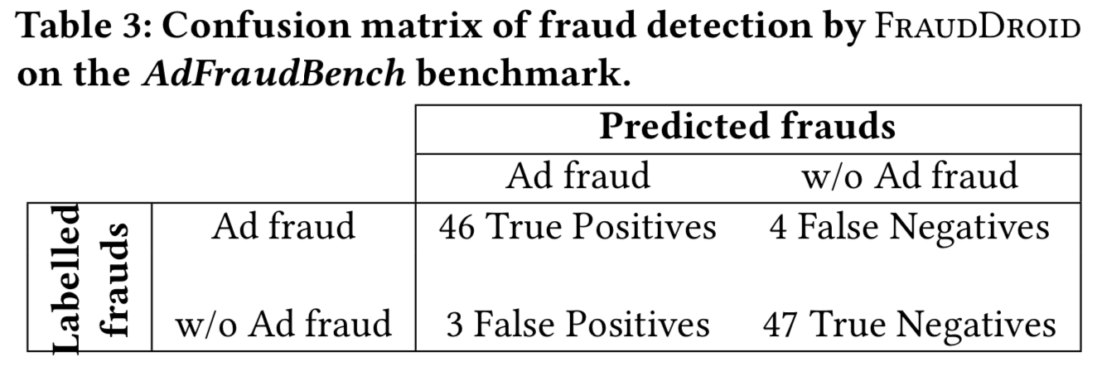
Evaluation
Detection Accuracy

Slide 15
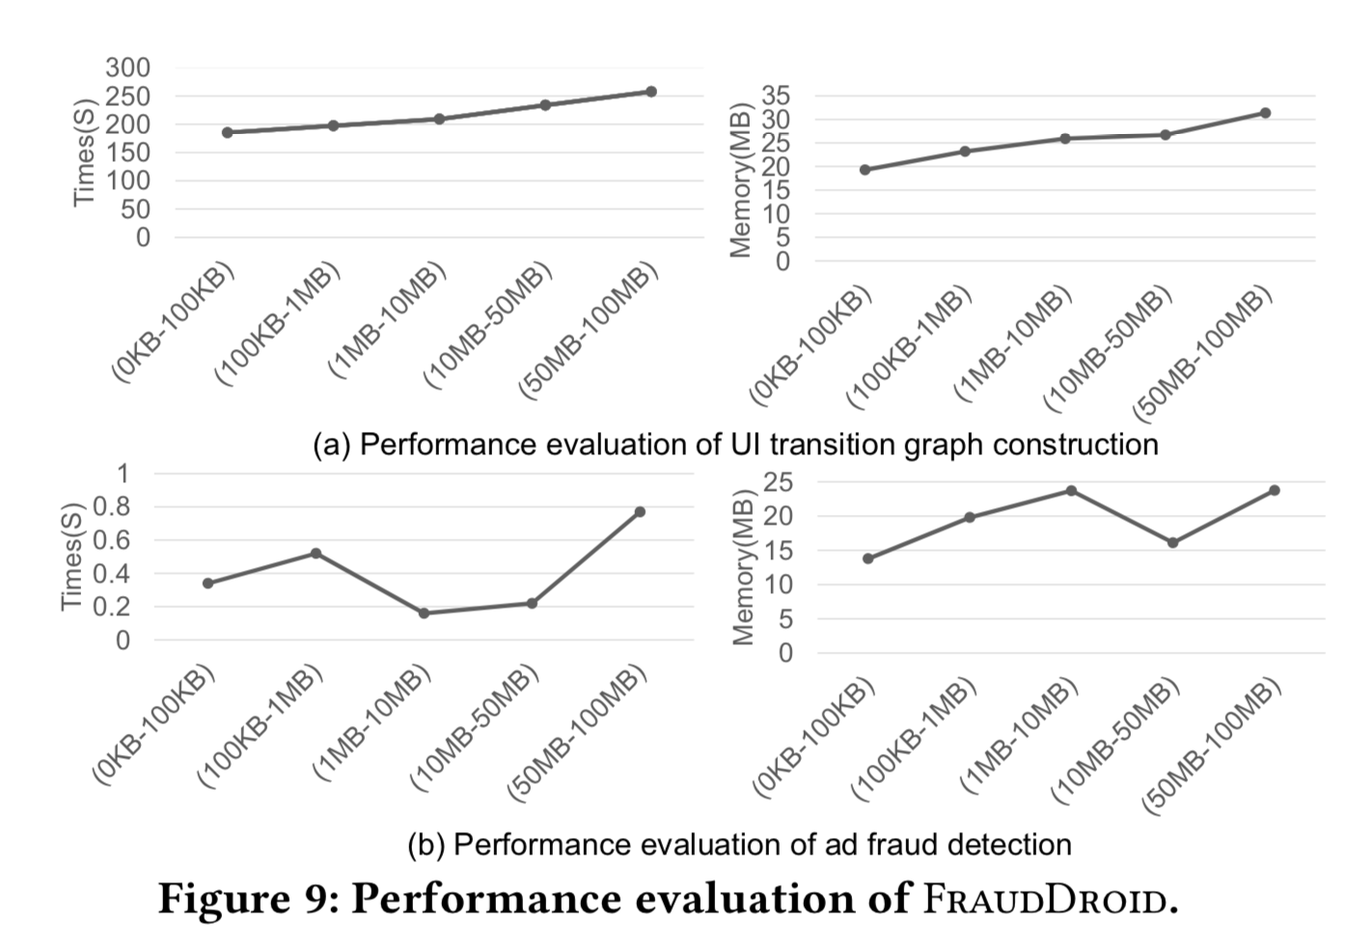
Evaluation
Scalability Accessment

Slide 16
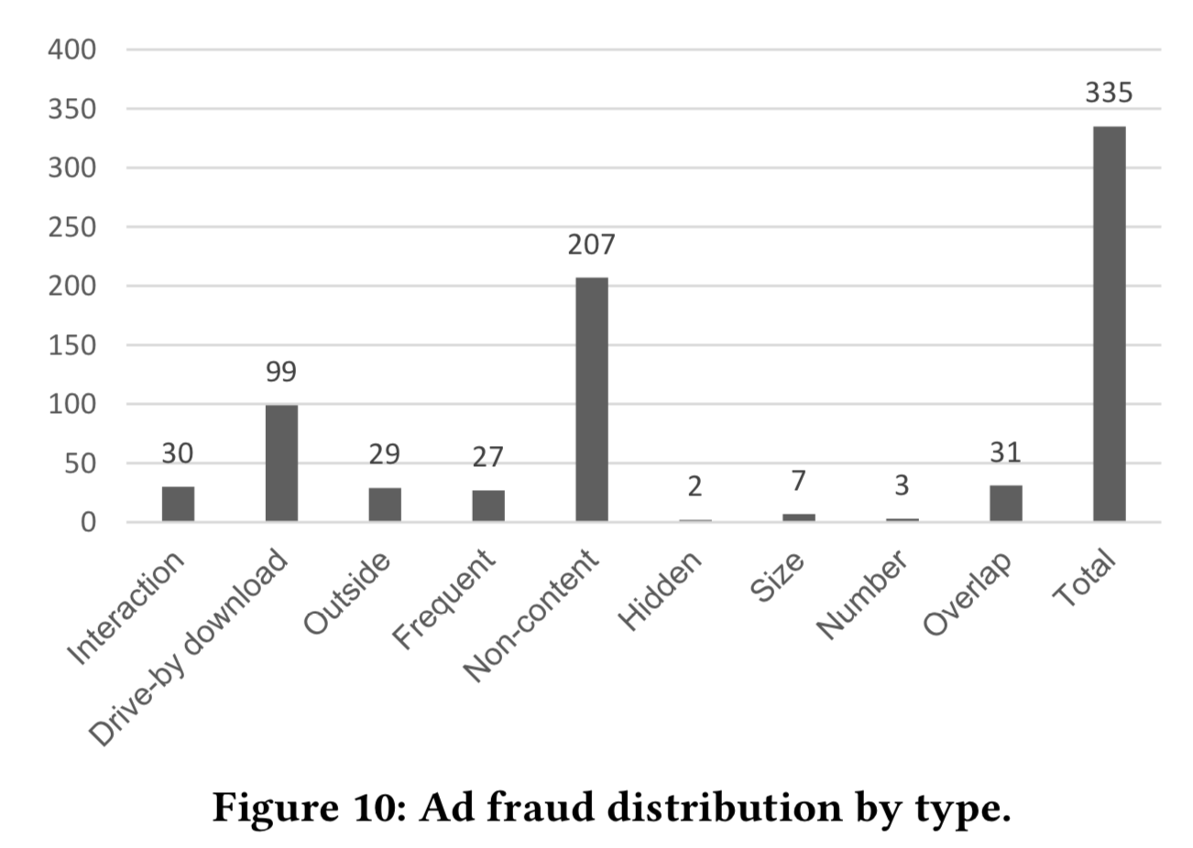
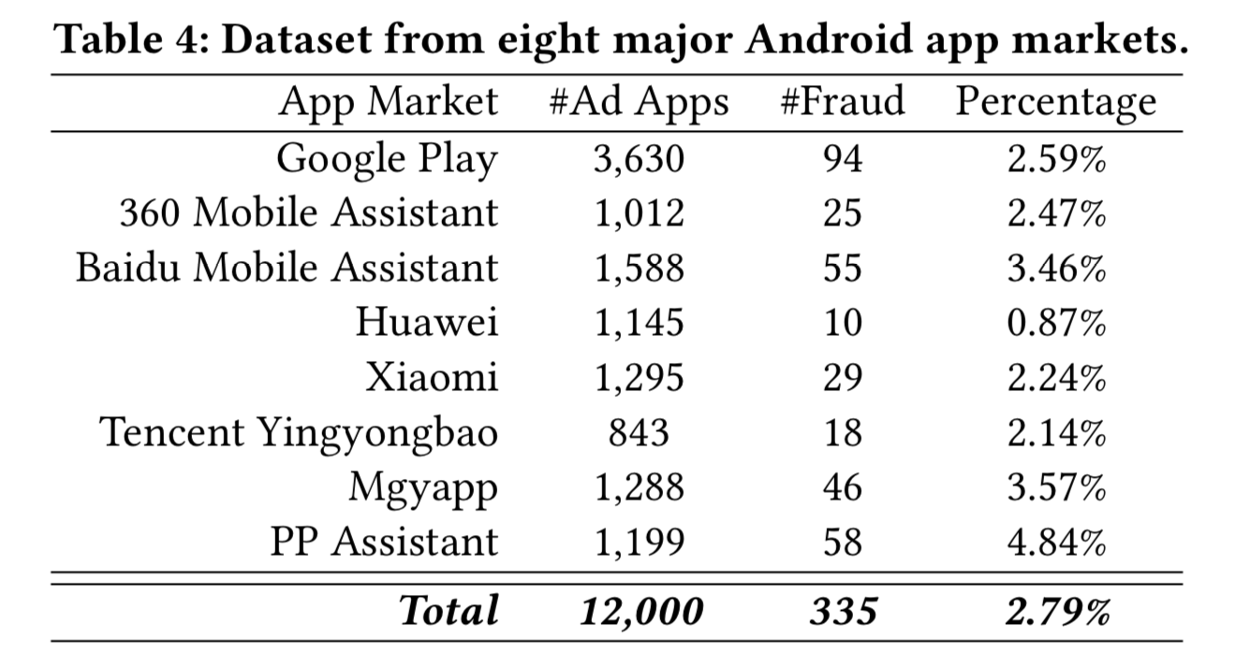
Evaluation
Detection In-the-Wild

